Slide 1
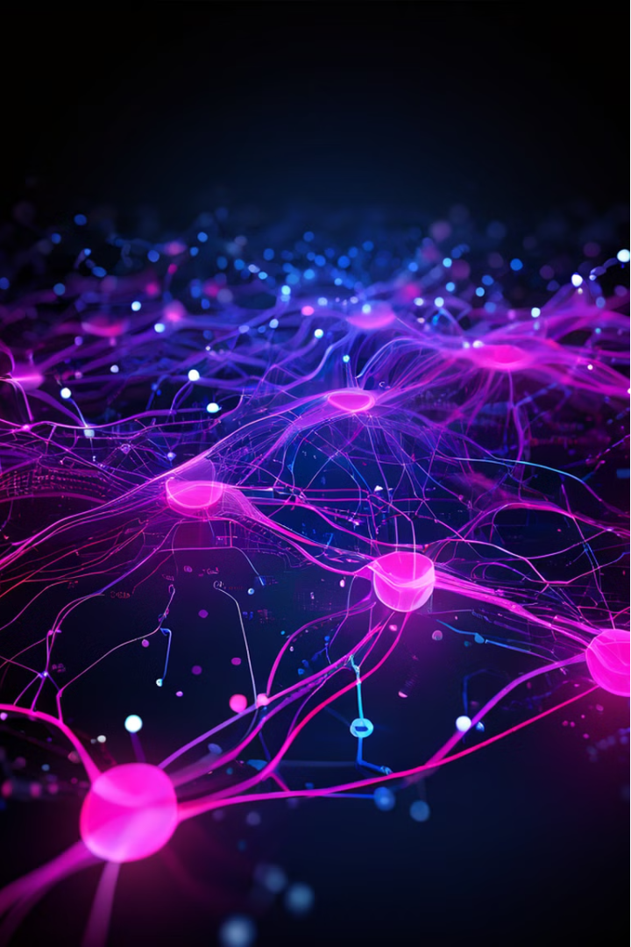
Image Classification by Neural Network
Building a neural network from scratch using numpy and math is a powerful way to deeply understand the mathematics behind machine learning. We will take you through the key steps we followed to create a functioning image classification model without relying on pre-built frameworks like Tensorflow and Pytorch.
Abdul Wasay Imran - 27126 Shaikh Muhammad Sharjeel - 26932

Slide 2
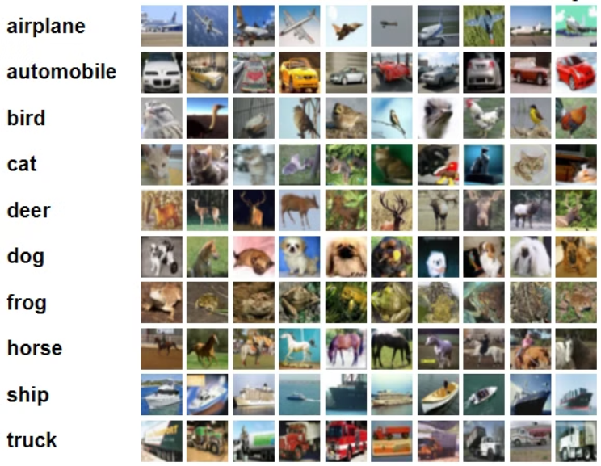
Problem: CIFAR-10 Classification
The goal is to classify the CIFAR-10 dataset, using a neural network, into the categories shown below.
The CIFAR-10 dataset consists of 60000 32x32 color images in 10 classes, with 6000 images per class. There are 50000 training images and 10000 test images.
We’ve only made use of the training data which we in turn split for training and testing our model.
These color images are then converted to gray-scaled images.*
* code file (Conversion.py) is attached with submission for conversion of CIDAR-10
dataset into a desired .csv file (also provided).

Slide 3

Network Architecture
Our neural network consists of 4 layers: an input layer, two hidden layers, and an output layer.
Input Layer
Hidden Layers
Output Layer
The input layer has 1024 nodes, corresponding to 1024 pixels in each image.
The two hidden layers consist of 16 units each.
The output layer also has 10 units - one for each category.

Slide 4
Mastering Forward Propagation
Input Layer
1
We start by feeding the input data, such as image pixels, into the neural network.
2
Hidden Layers
The data then flows through the two hidden layers, where activation functions like ReLU introduce non-linearity.
Output Layer
3
The final layer produces the predicted output, using a SoftMax activation to get probabilities for each class.

Slide 5
Backpropagation in Action
Calculating Gradients
Updating Parameters
Iterative Learning
We use backpropagation to compute the gradients of the loss function with respect to the weights and biases.
These gradients are then used to update the weights and biases through gradient descent, improving the model's performance.
By repeatedly performing forward propagation and backpropagation, the neural network learns to make more accurate predictions.

Slide 6

Gradient Descent Optimization
1
Hyperparameter Tuning
2
Convergence Monitoring
3
Regularization Techniques
Carefully selecting the learning rate and other hyperparameters is crucial for efficient gradient descent.
Tracking the loss function over training epochs helps us determine when the model has converged.
Techniques like L2 regularization can be used to prevent overfitting and improve generalization.

Slide 7

Evaluating Model Performance
Accuracy on CIFAR Set
Analyzing Errors
The model achieved an accuracy of 36% on the held-out test dataset.
Examining the confusion matrix helps us identify misclassified samples and areas for further improvement.
Complexity of Dataset
The CIFAR-10 dataset was indeed very complex, and the accuracy we achieved was a satisfiable one, considering the learning and resources available to us currently.

Slide 8




The Road Ahead
Explore Deeper
We will try to continue learning about advanced neural network architectures and techniques, such as convolutional and recurrent networks we came across when working on this project.
Experiment with Data
We can apply our skills to diverse data sets to broaden your understanding of machine learning.
Contribute to Research
Sharing our insights and findings with the machine learning community through socials, would help further the advancement of the field.

Slide 9

Thank You
We are grateful for the opportunity to present our work on neural networks. We hope the concepts and techniques we covered have been informative and insightful.
To view the presentation, click here.

